Slide 1


Weather and Bike-Sharing Demand Data Analysis Report
Dontai Wilson
02/2023

Slide 2
Outline
Executive Summary
Introduction
Methodology
Results
Conclusion
Appendix

Slide 3
Executive Summary
How can weather affect bike-sharing demand in urban areas?
Collecting the data from various reputable sources.
Seoul Bike Sharing Demand Data Set.
Open Weather API Data for Current Weather
Global Bike Sharing Systems Dataset
World Cities Data for Location and Bike Sharing Reports
Performing Exploratory Data Analysis
Visualizing The Data
Building an Interactive Dashboard
Summing up my findings

Slide 4
Introduction
When looking at bike-sharing demand in urban areas, weather is the ultimate determining factor. In this analysis, we’ve analyzed the bike sharing trends and cross compared them with weather reports from the respective cities. This allows us to determine what if-any weather trends have the biggest impact when it comes to demand of bike-sharing.
Data was collected from various sources such as, Wikipedia, and Open Weather API.
Performing cleaning and polishing of the Data.
Comparing the data, looking for trends and finding what factor has the biggest impact on bike-sharing demand.
Visualizing the factors, so you can see the impact.
Building a model, to make predictions based on future variables.
Putting all of this into a understandable web app, so you can choose what cities you would like to predict bike-sharing demand for in the future.

Slide 5
Methodology
Perform data collection, from relevant sources.
Perform data wrangling, cleaning the data so we can use the information that matters.
Perform exploratory data analysis (EDA) using SQL and visualization, for presenting these finding to you.
Perform predictive analysis using regression models, so we can predict future demand based on various weather factors.
Build a R Shiny dashboard app, so you can visualize future predictions based on upcoming expected weather.

Slide 6

Methodology
The ethical collection, and cleaning of relevant data. Drawing real conclusions that have an impact on expected weather trends, and demand predictions.

Slide 7
Data collection
Wikipedia
Open Weather
Current Weather
Historical Weather
Bike-Sharing Data
Historical Bike Sharing Data
In order to maintain reliability data has to be collected from relevant and trusted sources. For our analysis we decided to use:
Wikipedia, for historical bike-sharing system data.
Open Weather, for collecting current and historical weather information to cross compare against historical bike-sharing data.

Slide 8
Data wrangling
Once we have collected the necessary information, the next step is to polish the data so its easy to use. We also remove factors from the data that won't serve any importance to answering our question.
Since we would like to compare the how the weather will impact demand for bike-sharing, this means removing unnecessary information from our data set.
We need to ensure we have, bike-sharing history for select cities, as well as historical weather information for the same time period.
Some of the data points that we do require for our analysis have missing values, so we removed those rows, and filled in values for respective rows to ensure we can use our data to its fullest potential.
This step also required normalizing the data, so the all the variables have a relevant impact on our data analysis.

Slide 9

EDA with SQL
After loading the cleaned data into a database, I was able to perform some simple analysis on the data to find some relevant information. This analysis can be summarized as the following:
Determining how many recorded observations that I have to work with
Determining what seasons are covered in the datasets
Figuring out the date range of the data set
Finding the hour and date that had the most bike rentals
What the average hourly temp, and average number of bike rentals per hour for each season
The average, temp, humidity, wind speed, visibility, dew point temp, solar radiation, amount of rain, amount of snow, and the average rented bike per season
The total rented bike count and some geographical information about the city of Seoul.
Finally finding some comparable cities, that have a similar rented bike count to the one we used for our analysis, in order to make predictions about possible bike rentals based on weather conditions.

Slide 10

EDA with data visualization
Knowing about the data trends is one thing, but it’s a whole different story when you can visualize the data trends that are being observed.
For my analysis I created multiple plots that compare:
The amount of bikes rented each day broken up by the average time of day the bikes were rented.
A density plot that shows distribution of the data
The relationship of the rented bikes by temperature separated by season

Slide 11

Predictive analysis
Simple Linear Regression
Polynomial Model
Interactions
Regularizations
Grid Search
After comparing our data and finding the factors that show impact on the rented bike count, I built a model that could take in variables and output a prediction for demand of bike rentals based on the expected weather.
I started with splitting the data set into a training dataset and a testing dataset.
Next I trained the data using a simple linear regression model, this would allow me to compare which weather variables have the biggest impact on on bike-sharing demand. Checking this with the RMSE and RSQ values (a measure of the amount of error in my model)
After determining which factors have the biggest impact, I further refined my model by running models that include different factors such as Polynomials, interactions, regularization, and grid search. All to improve the accuracy of the model, using RMSE, and RSQ as the evaluation metrics.

Slide 12

Building a R Shiny dashboard
Now that we know the impact each weather factor has on the expected bike-sharing rentals, we can perform predictions with a level of confidence.
For this I decided the best option to showcase this ability is to build an interactive Shiny Dashboard. With this Dashboard you will have complete control of picking the city that you would like, to see expected bike-sharing demand based on the expected weather of that region.
From an overview stand point you will be able to see the cities that we can predict for
You can drill down into the the city, to see the expected weather trends for that city.
You can also observe the expected demand for bike-sharing for that city
You can also see the temperature trends for the selected city
The app also shows the bike predictions based on the expected Humidity for the city you select.

Slide 13
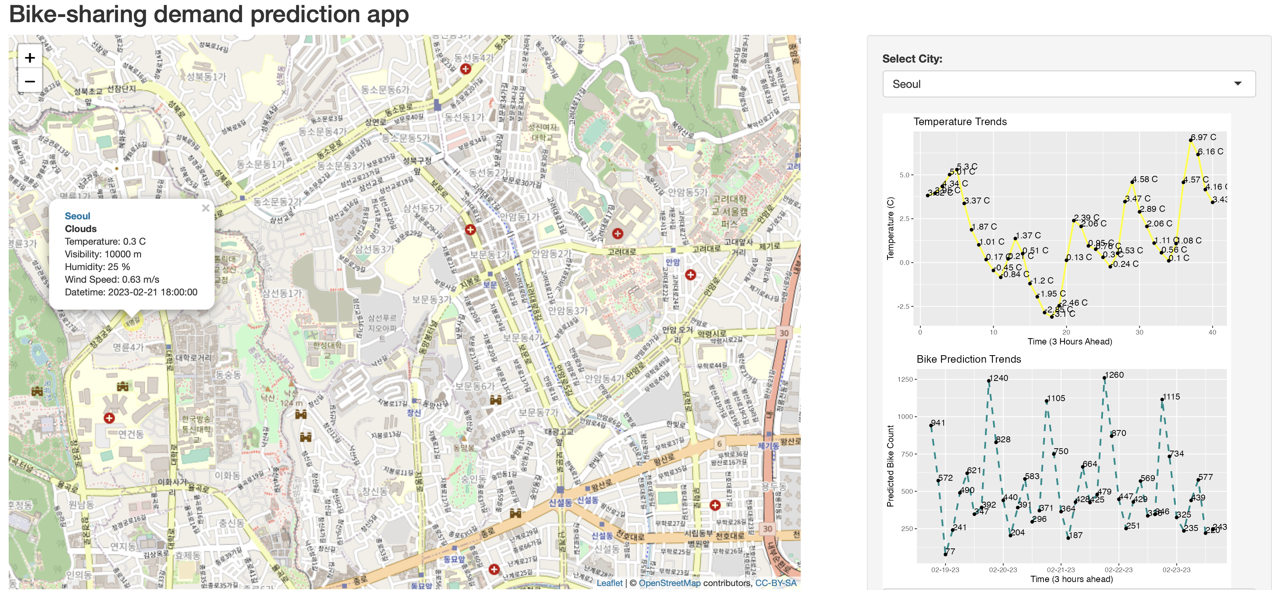
Results
After careful analysis, we have determined the biggest impacts on bike-sharing demand is the Temperature, and the Humidity. While there are other factors which play a role in demand, temp and humidity are the two biggest factors in demand.
We have also determined that there is a larger demand between the hours of 6 to 8 pm, and that summer is the best season for demand.

